Slide 1
LoadRunner vs. JMeter
FOR PERFORMANCE TESTING
By: Deborah Barndt, Hongqiao Liu, Shameemah F.-Codjoe and Vikas Kasu
Notes:
Shameemah

Slide 2

OUTLINE
Performance testing and why it is important
1
2
The ins and outs of LoadRunner
3
All about JMeter
4
Comparing the two - Who wins?
5
Conclusions
Shameemah
Notes:
Shameemah

Slide 3
Performance Testing
1
What is it and why do we need it?
Shameemah
Notes:
Shameemah

Slide 4
What is Performance Testing?
A type of testing to ensure software applications will perform well under their expected workload.
Comes under the category of non-functional testing techniques.
Shameemah
Notes:
Shameemah

Slide 5
Performance Testing Contd...
The focus of performance testing is checking a software program’s:
Speed - whether the application responds quickly.
Scalability - maximum user load the software can handle
Stability - if the application is stable under varying loads
Shameemah
Notes:
Shameemah

Slide 6
Types of Performance Testing
Performance Test Type | Objective
Load Testing | Identify performance bottlenecks
Stress Testing | Identify breaking point of application
Endurance Testing | Ensure application can handle expected load over a long period of time
Spike Testing | Test software’s reaction to large spikes in load
Volume Testing | Check application’s performance under varying database volumes
Scalability Testing | Determine application’s effectiveness in scaling up

Slide 7
$4,400,000,000
5 minutes
$1100/second
in revenue is lost annually due to poor web performance
of down time costs Google $545,000
of sales was lost by companies due to AWS outages
Shameemah
Notes:
Shameemah
An estimated loss of 4.4 billion in revenue is recorded annually due to poor web performance.
In today's age of Web 2.0, users click away if a website doesn't respond within 8 seconds. Imagine yourself waiting for 5 seconds when searching for Google or making a friend request on Facebook. The repercussions of performance downtime are often more devastating than ever imagined. We've examples such as those that recently hit Bank of America Online Banking, Amazon Web Services, Intuit or Blackberry.
According to Dunn & Bradstreet, 59% of Fortune 500 companies experience an estimated 1.6 hours of downtime every week. Considering the average Fortune 500 company with a minimum of 10,000 employees is paying $56 per hour, the labor part of downtime costs for such an organization would be $896,000 weekly, translating into more than $46 million per year.
Only a 5-minute downtime of Google.com (19-Aug-13) is estimated to cost the search giant as much as $545,000.
It's estimate that companies lost sales worth $1100 per second due to a recent Amazon Web Service Outage.
When a software system is deployed by an organization, it may encounter many scenarios that possibly result in performance latency. A number of factors cause decelerating performance, few examples may include:
Increased number of records present in the database
Increased number of simultaneous requests made to the system
a larger number of users accessing the system at a time as compared to the past

Slide 8
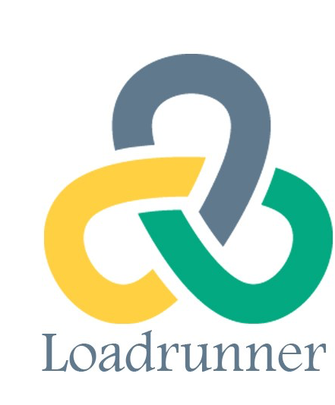









POPULAR TOOLS FOR PERFORMANCE TESTING
Shameemah
Notes:
Shameemah

Slide 9
LoadRunner
2
Architecture, Usage and Features
Vikas
Notes:
Vikas

Slide 10
What is LoadRunner?
An automated load testing platform that uses generated virtual user testing scripts to create performance test runs on an application.
The only tool in the market that supports a large number of protocols to conduct Performance Testing.
Vikas
Notes:
Vikas
LoadRunner was initially started by Mercury in 1999. which was then acquired by HP in 2006. It was later then acquired by MicroFocus in 2016.
LoadRunner supports various development tools, technologies and communication protocols. In fact, this is the only tool in the market which supports such large number of protocols to conduct Performance Testing.
Broadly, LoadRunner supports RIA (Rich Internet Applications), Web 2.0 (HTTP/HTML, Ajax, Flex and Silverlight etc.), Mobile, SAP, Oracle, MS SQL Server, Citrix, RTE, Mail and above all, Windows Socket. There is no competitor tool in the market which could offer such wide variety of protocols vested in a single tool.

Slide 11
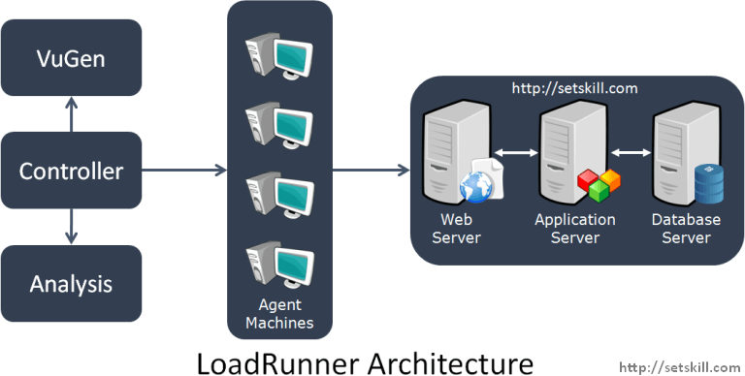
LoadRunner Architecture
Vikas
Notes:
Vikas

Slide 12
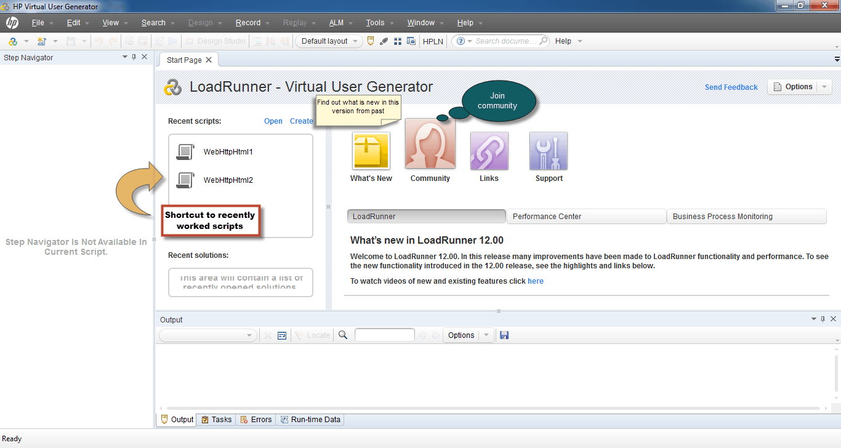
VuGen
(Virtual User Generator)
VUGen is an IDE or a rich coding editor, used to replicate System Under Load (SUL) behavior.
It provides a "recording" feature which records communication to and from the client and server in the form of a coded script - also called VUser script.
Vikas
Notes:
Vikas
VUGen or Virtual User Generator is an IDE (Integrated Development Environment) or a rich coding editor. VUGen is used to replicate System Under Load (SUL) behavior. VUGen provides a "recording" feature which records communication to and from the client and Server in the form of a coded script - also called VUser script.
So considering the above example, VUGen can record to simulate following business processes:
Surfing the Products Page of Amazon.com
Checkout
Payment Processing
Checking MyAccount Page

Slide 13
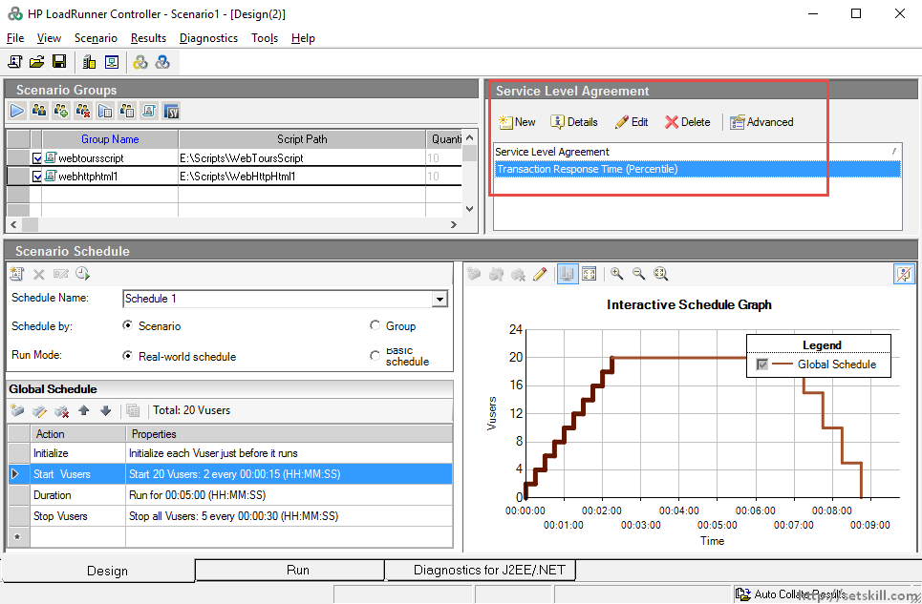
Controller
Once a VUser Script is finalized, the Controller is the main component which controls the load simulation by managing, for example:
How many VUsers to simulate against each business group
Behaviour of VUsers (ramp up, ramp down, etc)
Nature of load scenario
Vikas
Notes:
Vikas
Once a VUser script is finalized, the Controller is the main component which controls the Load simulation by managing, for example:
How many VUsers to simulate against each business process or VUser Group
Behaviour of VUsers (ramp up, ramp down, simultaneous or concurrent nature etc.)
Nature of Load scenario e.g. Real Life or Goal Oriented or verifying SLA
Which injectors to use, how many VUsers against each injector
Collate results periodically
IP Spoofing
Error reporting
Transaction reporting etc.

Slide 14
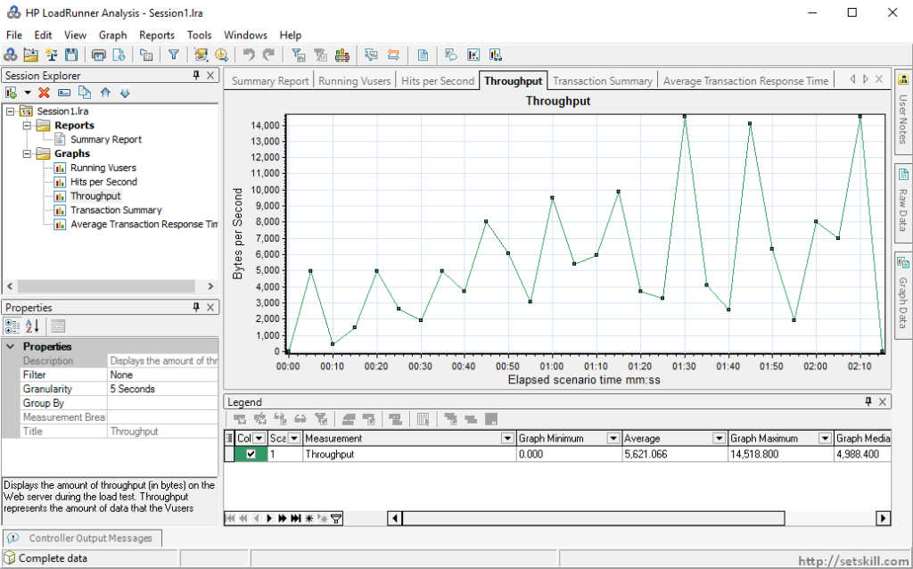
Analysis
All data and performance results are stored in a central point, providing developers with crucial information on the app’s performance, bottlenecks and breaking points.
The Analysis component uses this data to perform various types of analysis and generates graphs.
Vikas
Notes:
Vikas
Once Load scenarios have been executed, the role of "Analysis" component comes in.
During the execution, Controller creates a dump of results in raw form & contains information like, which version of LoadRunner created this results dump and what were configurations.
All the errors and exceptions are logged in a Microsoft access database, named, output.mdb. The "Analysis" component reads this database file to perform various types of analysis and generates graphs.
These graphs show various trends to understand the reasoning behind errors and failure under load; thus help to figure whether optimization is required in SUL, Server (e.g. JBoss, Oracle) or infrastructure.
Below is an example where bandwidth could be creating a bottleneck. Let's say Web server has 1GBps capacity whereas the data traffic exceeds this capacity causing subsequent users to suffer. To determine system caters to such needs, Performance Engineer needs to analyze application behavior with an abnormal load. Below is a graph LoadRunner generates to elicit bandwidth.

Slide 15
Agent Machines/Load Generators/Injectors
The LoadRunner Agent enables the Controller and the load generator to communicate with each other.
When you run a scenario, the Controller instructs the Remote Agent Dispatcher (Process) to launch the LoadRunner agent.
The agent receives instructions from the Controller to initialize, run, pause, and stop Vusers. At the same time, the agent also relays data on the status of the Vusers back to Controller.
Vikas
Notes:
Vikas
LoadRunner Controller is responsible to simulate thousands of VUsers - these VUsers consume hardware resources for example processor and memory - hence putting a limit on the machine which is simulating them. Besides, Controller simulates these VUsers from the same machine (where Controller resides) & hence the results may not be precise. To address this concern, all VUsers are spread across various machines, called Load Generators or Load Injectors.
As a general practice, Controller resides on a different machine and load is simulated from other machines. Depending upon the protocol of VUser scripts and machine specifications, a number of Load Injectors may be required for full simulation. For example, VUsers for an HTTP script will require 2-4MB per VUser for simulation, hence 4 machines with 4 GB RAM each will be required to simulate a load of 10,000 VUsers.

Slide 16
Performance Testing RoadMap with LoadRunner
Planning for Load Test
Create VUGen Scripts
Scenario
Creation
Scenario Execution
Results Analysis
Vikas
Notes:
Vikas
Plan load test - define goals, analyse system, gather system usage data
Create scripts - record scripts, enhance scripts, add test data
Scenario creation - create scenario, goals, SLAs
Scenario execution - Execute scenario, overload testing
Results analysis - analyze data, pinpoint bottleneck

Slide 17
JMeter
3
Elements and Usage
Deborah
Notes:
Deborah

Slide 18
What is JMeter?
A desktop application, designed to test and measure the performance and functional behavior of client/server applications, such as web applications or FTP applications.
One of the widely used open-source, freely distributed testing applications
Purely Java-based
Deborah
Notes:
Deborah
Apache JMeter is a pure Java open source software desktop application, which was first developed by Stefano Mazzocchi of the Apache Software Foundation It was designed to load test functional behavior and measure performance.
You can use JMeter to analyze and measure the performance of a web application or a variety of services. Performance Testing means testing a web application against heavy loads, and multiple and concurrent user traffic. JMeter was originally used for testing Web Applications or FTP applications. However nowadays, it is used for a functional tests, database server tests, and many more.

Slide 19
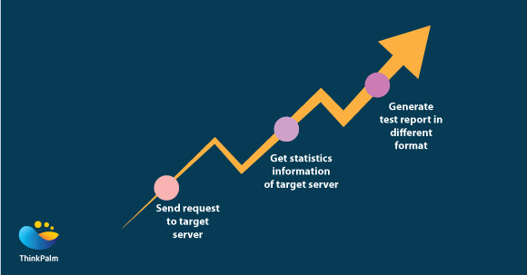
How JMeter Works
JMeter simulates a group of users sending requests to a target server, and then returns statistics that show the performance/functionality of the target server/application via tables, graphs, etc.
Deborah
Notes:
Deborah
JMeter simulates a group of users sending requests to a target server, and then returns statistics that show the performance or functionality of the target server or application in the form of tables, graphs, or log files.

Slide 20
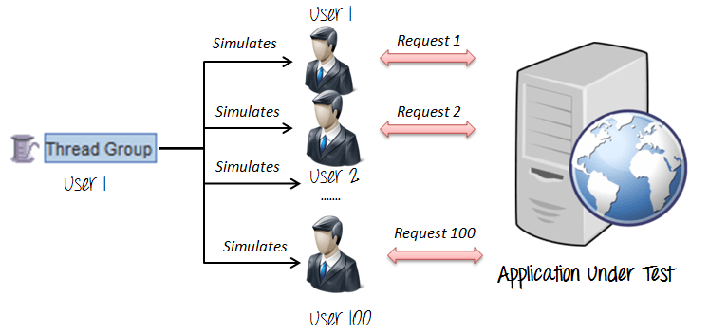
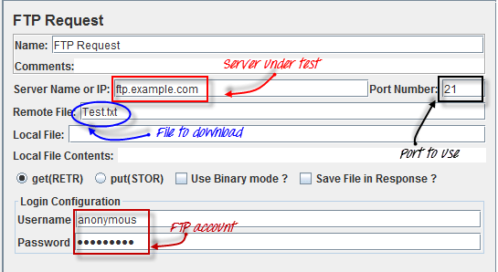
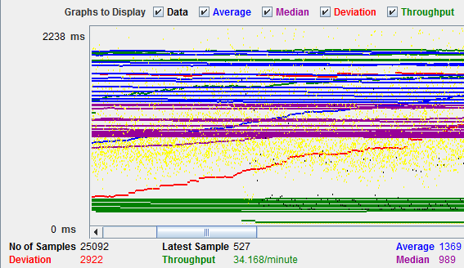
JMeter Elements
Thread Group
Thread Groups is a collection of Threads and each thread represents one user using the application under test.
Samplers
Samplers determine the type of request a thread group can make. Eg. HTTP, FTP, JDB, etc.
Listeners
Listeners show the results of the test execution. This can be in different formats like graphs, tables or log files.
Deborah
Notes:
Deborah
Some of the elements of JMeter include Thread groups, Samplers, and Listeners.
A thread group is a collection of threads, and each thread represents one user using the application under a test.
Samplers determine the type of request a thread group can make such as HTTP, FTP, JDB, and more.
Listeners show the results of the test execution, which can be in different formats such as graphs, tables, or log files.

Slide 21
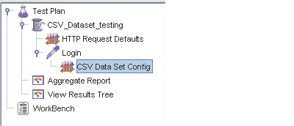
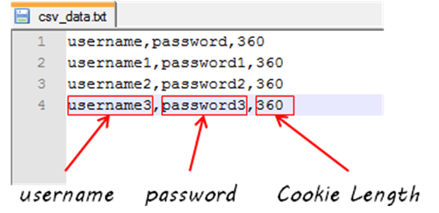
JMeter Elements Contd...
Config Elements
These are used to set up defaults and variables for later use by samplers.
Deborah
Notes:
Deborah
Another element of JMeter are Config elements.
These elements are used to set up defaults and variables for later use by samplers.

Slide 22
Performance Testing Roadmap with JMeter
Add Thread Group
Add JMeter Elements
Add Graph Result
Run Test and Get Result
Deborah
Notes:
Deborah
The Performance Testing Roadmap for JMeter consists of four steps: Add a Thread Group, Add JMeter Elements, Add a Graph Result, and Run the Tests and get the results.
To do this you would first:
Plan a load test by defining the goals, analyzing the system, and gathering system usage data
Create scripts - by recording scripts, enhancing the scripts, and adding test data
Scenario creation - which is creating scenarios, goals, and SLAs
Scenario execution - involves executing the scenario, and doing overload testing
Results analysis - where you analyze the data, and pinpoint bottleneck

Slide 23
Comparing The Two
4
LoadRunner vs JMeter
Deborah
Notes:
Deborah

Slide 24
Load Generating Capacity
JMeter
Can run as many number of agents as the hardware allows
Repeatedly computing large files can cause load to fall off quickly
LoadRunner
Limits the number of users
Aggregate of load generated is very efficient as it utilizes less hardware
Deborah
Notes:
Deborah
The first thing we compared was the Load Generating Capacity.
With JMeter, you can run as many number of agents as the hardware will allow, but repeatedly computing large files can cause load to fall off quickly.
With LoadRunner, it limits the number of users, but the aggregate of the load generated is very efficient as it utilizes less hardware.

Slide 25
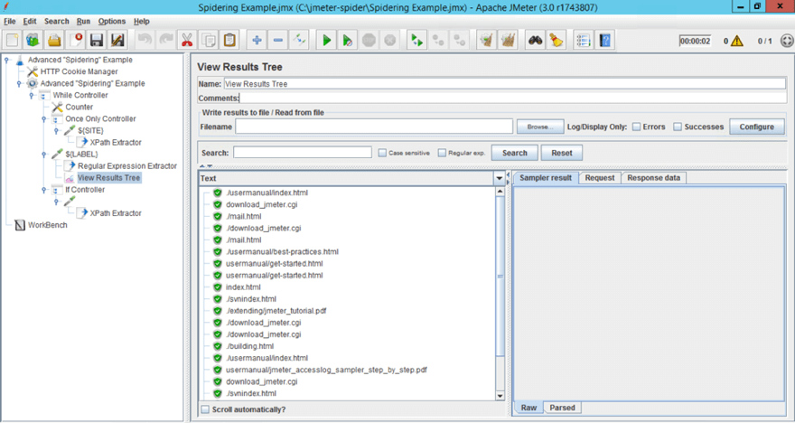
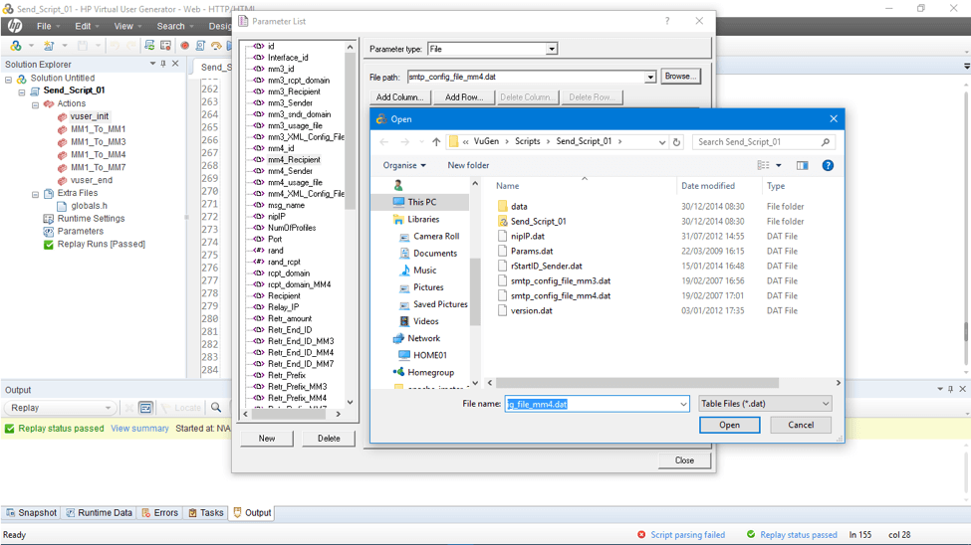
GUI
JMeter GUI
LoadRunner GUI
JMeter has a more comprehensive and user-friendly GUI.
Deborah
Notes:
Deborah
JMeter has a comprehensive and user-friendly GUI. Parameters are easy to define and understand, scripting is simpler and clearer also adding and defining elements is more intuitive. In addition, one screen shows you everything you need - the script, the scenario and the analysis.
In LoadRunner, scripting configuration, scenario definition and analysis take place in separate places. In addition, parameters are more cumbersome and they need to be defined in a separate text file.
And now Hong-chow is going to continue to comparing the two

Slide 26
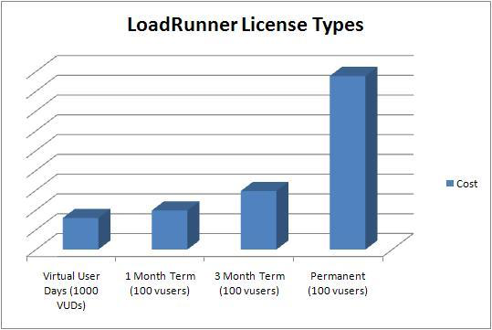
Cost
JMeter
LoadRunner
Open source with no licensing cost
$915,200 for 3 Year Software Fees
FREE!!
Hongqiao
Notes:
Hongqiao
LoadRunner
Expected to start from a low six figure, which might go up to a mid six figure
This is the approximate cost required to obtain a license in order to allow various kinds of robust load generation capacity
There are several other costs needed to support the performance of LoadRunner
Running large scale performance test make it more expensive, but it can get over 100 machines which can be utilized as scale agents and also as associated network switches, cabling, and much more
JMeter
Is free, so does not involve any cost for acquiring the license to allow different kinds of load generation capacity
Includes desktop applications that are open source software which adds to its advantage and makes it more likely to be used
Is extensible which contributes in reducing the cost

Slide 27
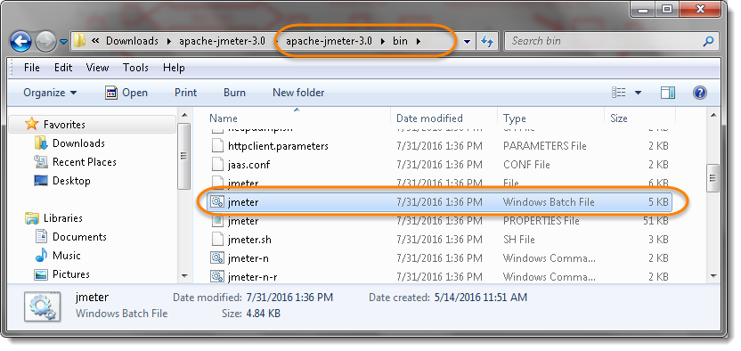
Installation
JMeter
Unpack the tar file and installation is complete
Sun’s JRE needs to be installed
LoadRunner
Takes up a lot of time and disk space
Works on particular version of windows
User interface can be confusing to users
Hongqiao
Notes:
Hongqiao
LoadRunner
Takes a lot of time
Takes up a lot of disk space
Works on a particular version of Microsoft Windows
Puzzling user interface can prove to daunt the users
Setting up simple tests
It supports browser recording and icon-based scripts
JMeter
Sun’s JRE needs to be installed
Unpack the tar file and it is installed
Setting up simple tests
Fast and simple
Start the console, few clicks of the mouse, and it is ready to create load
Running tests
Both distributed and local
Tests can be started from the user interface
Available agents are displayed, busy agents are grayed out

Slide 28
Defining Elements
JMeter
Right click on tree scenario and add what you need
You can fill in configuration or copy and paste from text file
Comments can be added
LoadRunner
Requires complex scripting in C
Needs to be defined in text file before integrating with scenario.
Hongqiao
Notes:
Hongqiao

Slide 29
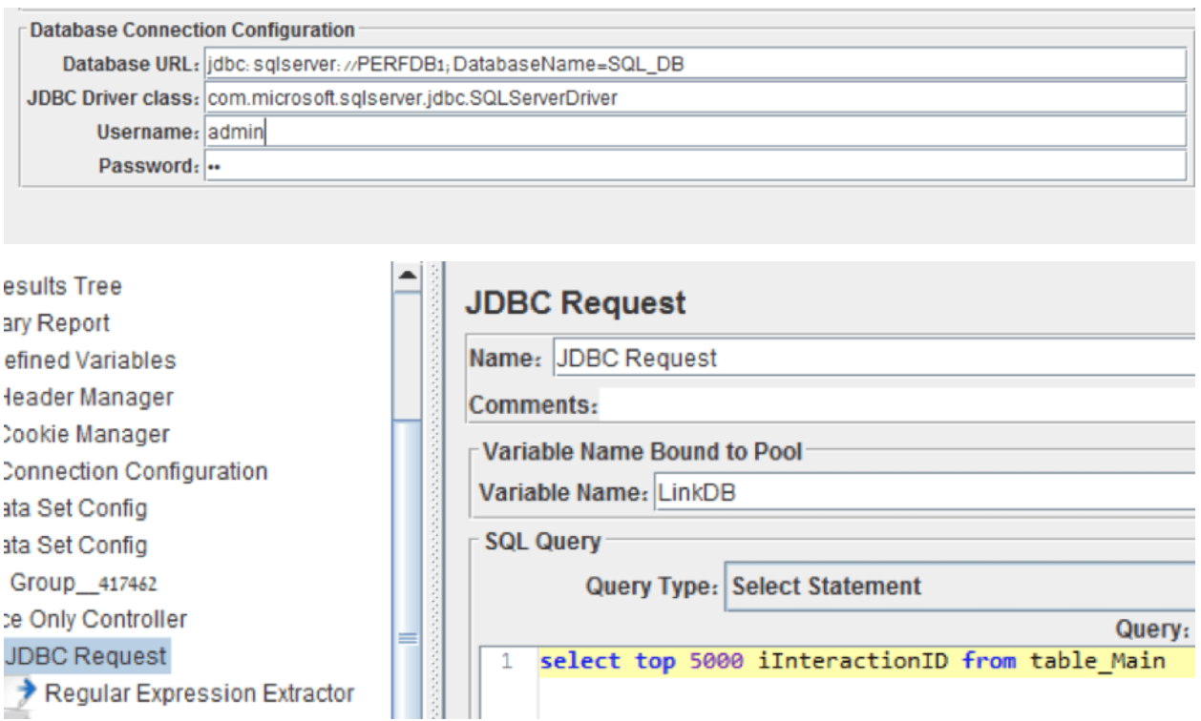
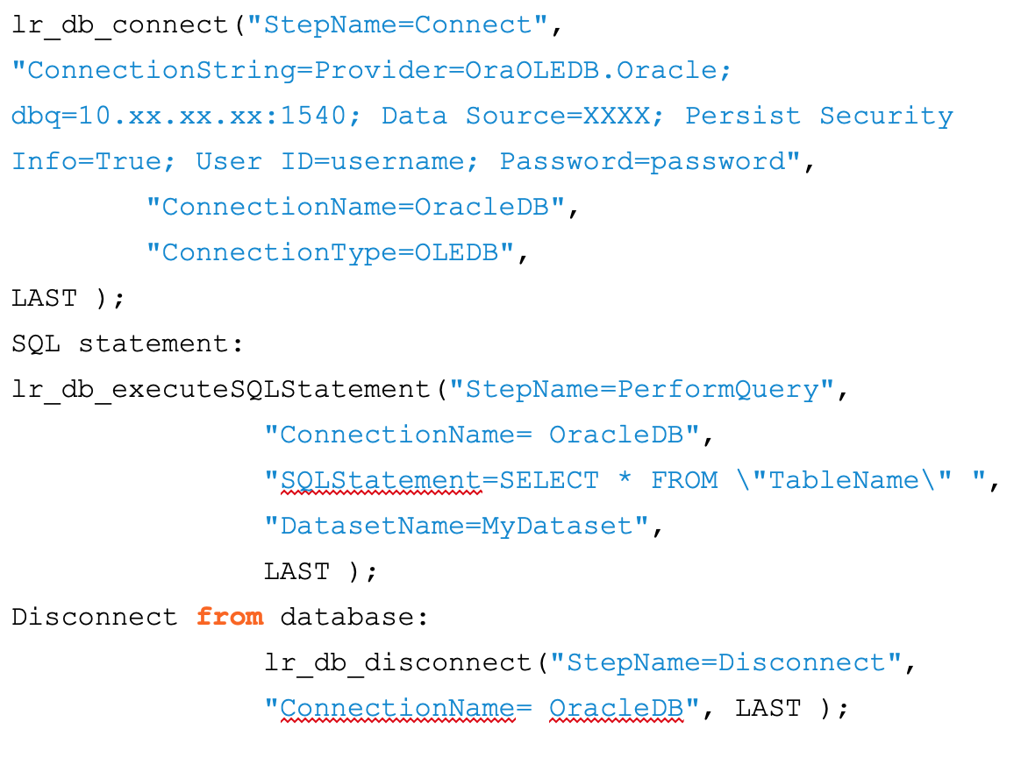
Defining Elements Contd...
Adding a DB connection:
JMeter
LoadRunner
Hongqiao
Notes:
Hongqiao

Slide 30
Protocol Support
JMeter
HTTPS
JDBC
FTP
LDAP
JMS
LoadRunner
RIA (Rich Internet Applications)
Web 2.0 - HTTP/HTML, Ajax, Flex, Silverlight
Mobile
SAP
Oracle
MS SQL Server
ODBC
Citrix
RTE
Mail
Windows Socket
Hongqiao
Notes:
Hongqiao

Slide 31




Platform Compatibility
JMeter
LoadRunner
Hongqiao
Notes:
Hongqiao

Slide 32
Stability
JMeter
Becomes difficult to work with if scenarios are complex
Can easily handle a load of 50 - 100, but not as much as LoadRunner
LoadRunner
Better choice when the load involved is extremely high
Robustness is one of its main features which makes it more stable
Hongqiao
Notes:
Hongqiao

Slide 33
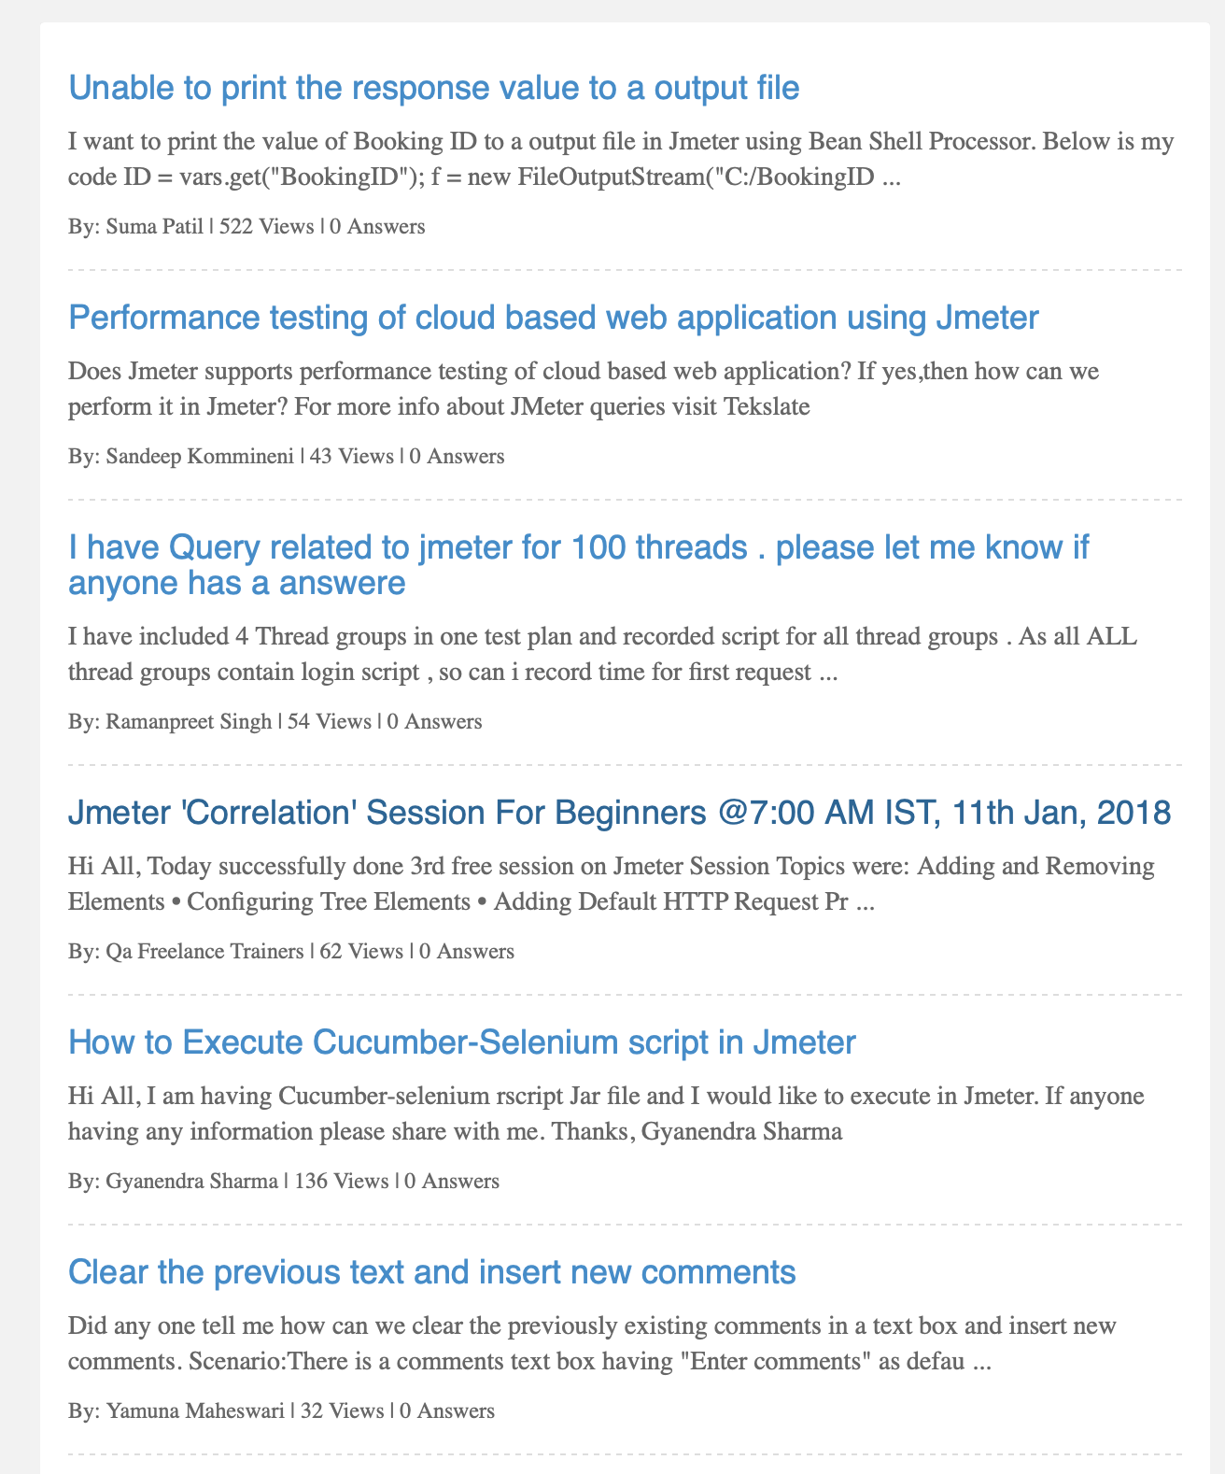
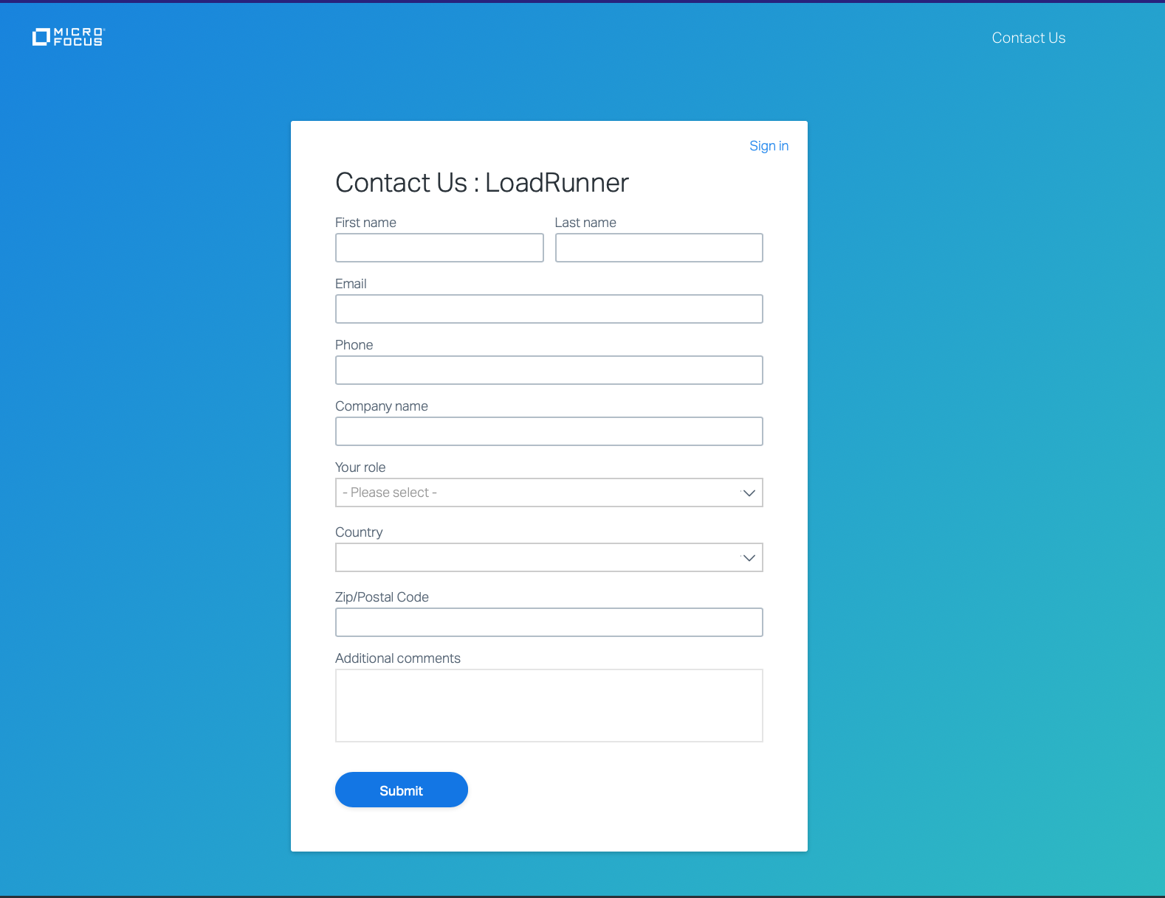
Customer Support
JMeter
Reliance on forum/blog communities to solve issues
LoadRunner
Has dedicated customer support team to address issues
Hongqiao
Notes:
Hongqiao

Slide 34
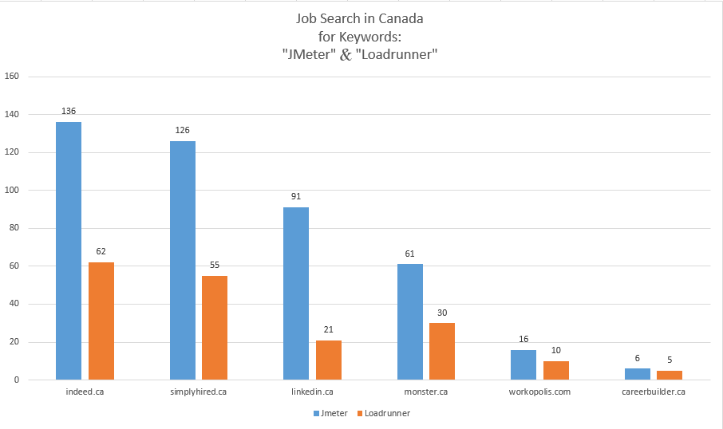
Job Market
The chart shows that
JMeter appears in more job ads than LoadRunner.
Hongqiao
Notes:
Hongqiao Shmema will conclude these two application.

Slide 35
Conclusions
5
What tool should you use?
Shameemah
Notes:
Shameemah

Slide 36
Both tools have their advantages and disadvantages. LoadRunner is the industry standard and is best for performance testing with complex scenarios and very high loads. If you need a cheaper, more user friendly option for fewer loads, JMeter is the best pick!
Shameemah
Notes:
Shameemah

Slide 37
References
Apache JMeter™. (n.d.). Retrieved from https://jmeter.apache.org/
Apache JMeter vs HP Loadrunner 2018 Comparison | FinancesOnline. (n.d.). Retrieved from https://comparisons.financesonline.com/apache-jmeter-vs-hp-loadrunner
Cohen, N. (2017, February 14). 7 Reasons JMeter is Easier to Use Than LoadRunner. Retrieved from https://www.blazemeter.com/blog/7-reasons-jmeter-easier-use-loadrunner
Halili, E. H. (2008). Apache JMeter: A practical beginners guide to automated testing and performance measurement for your websites. Birmingham: Packt Pub.
Kurniawan, B. (2003). ONJava.com: Using JMeter. Retrieved from http://loadstorm.com/files/ONJava.com-Using-JMeter.pdf
Load Testing Software: Web and Mobile Application Testing Tool. (n.d.). Retrieved from https://software.microfocus.com/en-us/products/loadrunner-load-testing/overview
Masood, A. (2018, March 24). Top 4 Performance Testing Tools Comparison. Retrieved from http://www.testerlogic.com/top-performance-testing-tools-comparison/
Patel, B., Parikh, J., & Shah, R. (2014). A Review Paper on Comparison of SQL Performance Analyzer Tools: Apache JMeter and HP LoadRunner. International Journal of Current Engineering and Technology,4(5), 3642-3645. Retrieved from http://inpressco.com/category/ijcet
What is HP LoadRunner? Introduction, Architecture, Components. (n.d.). Retrieved from https://www.guru99.com/introduction-to-hp-loadrunner-and-its-archtecture.html
Shameemah
Notes:
Shameemah

Slide 38
THANKS!
Any questions?
You can email us dbarndt/hliu89/sfuseini/vkasu
@hawk.iit.edu
Shameemah
Notes:
Shameemah

